Slide 1
Chapter 5
ALGEBRAIC QUERY LANGUAGE

Slide 2
Objectives
Understand why must use Bags concept (multi-set)
Know relational operations on bags
Know extended operations on bags

Slide 3
Relational Operations on Bags
We consider relations as bags (multi-sets) rather than sets, that is
  We allow the same tuples to appear more than once in a relation
We need to make changes to the definition of some relational operations

Slide 4
Relational Operations on Bags
Example
  In this figure, the tuple (1,2) appears 3-times
  As a set-valued relation, we would have to eliminate 2-occurences of the tuple (1,2)
  As a bag-valued relation, we allow multiple occurrences of the same tuple, but like sets, the order of tuples does not matter
A | B
1 | 2
3 | 4
1 | 2
1 | 2

Slide 5
Why Bags?
As mentioned, relations in commercial DBMS are implemented relations as bags rather than sets
Some relational operations are considerably more efficient if we use the bag model
  Union
  Projection

Slide 6
Why Bags?
Example
  Have a look at a projection on A and B
  What happens if we’d like to take the average of the A-components?
  What do you consider between treating as set-valued and treating as bag-valued relation?
A | B | C
1 | 2 | 5
3 | 4 | 6
1 | 2 | 7
1 | 2 | 8

Slide 7
Union, Intersection, and Difference of Bags
Suppose R and S are bags, and t is the tuple that appears n-times and m-times in R and S (n≥0, m≥0). Then we have:
  In {R ∪ S}, t appears (n + m) times
  In {R ∩ S}, t appears MIN(n, m) times
  In {R \ S}, t appears MAX(0, n - m) times

Slide 8
Union, Intersection, and Difference of Bags
Example
R
S
R∪S
R∩S
R\S
A | B
1 | 2
3 | 4
1 | 2
1 | 2
A | B
1 | 2
3 | 4
3 | 4
5 | 6
A | B
1 | 2
3 | 4
1 | 2
1 | 2
1 | 2
3 | 4
3 | 4
5 | 6
A | B
1 | 2
3 | 4
A | B
1 | 2
1 | 2

Slide 9
Projection of Bags
Each tuple is processed independently during the projection
Don’t eliminate duplications
A | B | C
1 | 2 | 2
2 | 4 | 4
1 | 2 | 2
1 | 2 | 2
A | B
1 | 2
2 | 4
1 | 2
1 | 2
π_{A,B}(R)

Slide 10
Selection on Bags
To apply a selection to a bag, we apply the selection condition to each tuple independently
Don’t eliminate duplications
A | B | C
1 | 2 | 2
2 | 4 | 4
1 | 2 | 2
1 | 2 | 2
A | B | C
1 | 2 | 2
1 | 2 | 2
1 | 2 | 2
σ_{C=2}(R)

Slide 11
Product of Bags
Each tuple of one relation is paired with each tuple of the other, regardless of whether it is a duplicate or not
If a tuple r appears in relation R m-times, and tuple s appears in relation S n-times, then in the product RxS, the tuple rs will appear mn-times

Slide 12
Product of Bags
Example
R
S
RxS
A | B
1 | 2
1 | 2
B | C
2 | 3
4 | 5
4 | 5
A | R.B | S.B | C
1 | 2 | 2 | 3
1 | 2 | 2 | 3
1 | 2 | 4 | 5
1 | 2 | 4 | 5
1 | 2 | 4 | 5
1 | 2 | 4 | 5

Slide 13
Joins of Bags
Each tuple of one relation is paired with each tuple of the other if they satisfy the join condition whether there are duplicates or not

Slide 14
Joins of Bags
Example
R
S
R ⋈ _{R.B<S.B} S
A | B
1 | 2
1 | 2
B | C
2 | 3
4 | 5
4 | 5
A | R.B | S.B | C
1 | 2 | 4 | 5
1 | 2 | 4 | 5
1 | 2 | 4 | 5
1 | 2 | 4 | 5

Slide 15
EXTENDED OPERATIONS OF RELATIONAL ALGEBRA

Slide 16
Extended Operators of Relational Algebra
There are some extended operators
  Duplicate-elimination operator δ
  Aggregation operators (used by the grouping operator)
  Grouping operators
  Extended projection
  Sorting operators
  Outer join operators

Slide 17
Duplicate Elimination
δ(R) is used to convert a bag to a set
A | B | C
1 | 2 | 2
3 | 4 | 4
1 | 2 | 2
1 | 2 | 2
A | B | C
1 | 2 | 2
3 | 4 | 4
δ (R)

Slide 18
Aggregation Operators
These operators are used to summarize or aggregate the values in one column of a relation
The standard aggregation operators
  SUM
  AVG
  MIN
  MAX
  COUNT

Slide 19
Aggregation Operators
Example
  SUM(B)=2+4+2+2=10
  AVG(A)=(1+3+1+1)/4=1.5
  MIN(A)=1
  MAX(B)=4
  COUNT(A)=4
A | B | C
1 | 2 | 2
3 | 4 | 4
1 | 2 | 2
1 | 2 | 2

Slide 20
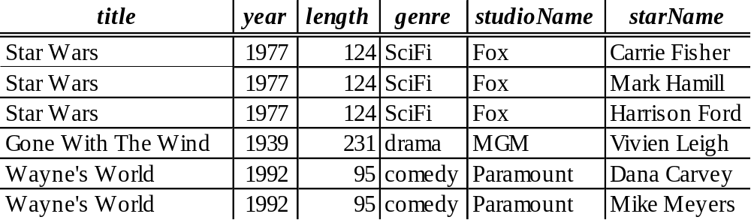
How do we ...
Compute the total number of stars of each movie
  First, list all stars for each movie, and store in temporary relation (there are three such relations)
  Then, for each relation, use the COUNT aggregation operator to count the number of tuples
This approach is so complicated

Slide 21
So how we do?
First, we group the tuple of Movies
Then, we apply the aggregation COUNT to each group independently
That is, we use the grouping operator

Slide 22
Grouping and Grouping Operator
The grouping operator is denoted by γ_{L}(R), where L is a list of elements:
  An attribute of the relation R to which the γ is applied, this attribute is one of the attributes by which R will be grouped, is called by grouping attribute
  An aggregation operator applied to an attribute of the relation, this attribute is said to be an aggregating attribute
The result of γ_{L}(R) is constructed as follow:
  Partition the tuples of R into groups on grouping attributes in list L
  For each group, produce one tuple consisting of:
    The grouping attributes’ values for that group and
    The aggregations, over all tuples of that group, for the aggregated attributes on list L

Slide 23
Grouping and Grouping Operator
Example: Compute the total number of stars of each movie?
  γtitle->movieTitle, year->movieYear, COUNT(starName)->totalStars(Movies)
movieTitle | movieYear | totalStars
Star Wars | 1977 | 3
Gone With The Wine | 1939 | 1
Wayne’s World | 1992 | 2

Slide 24
Extending the Projection Operator
An extended projection, denoted π_{L}(R), L list can have the following kinds of elements:
  A single attribute of R
  An expression x → y, where x, y are attributes, means that rename x attribute of R to y
  An expression E → z, where E is an expression involving attributes of R, constants, arithmetic operators, string operators, and z is new attribute that results from E

Slide 25
Extending the Projection Operator
Example
A | B | C
0 | 1 | 2
0 | 1 | 2
3 | 4 | 5
A | X
0 | 3
0 | 3
3 | 9
π_{A,B+C->X}(R)

Slide 26
The Sorting Operator
Sort the tuples of a relation by one or more of its attributes
τ_{L}(R), where R is a relation and L is a list of some of R’s attributes
Example
A | B | C
1 | 1 | 2
4 | 1 | 2
3 | 4 | 5
2 | 2 | 2
A | B | C
1 | 1 | 2
2 | 2 | 2
3 | 4 | 5
4 | 1 | 2
τ_{A}(R)

Slide 27
Outer joins
A property of the join is that it is possible for certain tuples that can match any tuple of the other relation in the common attributes
Example:
  What do you consider?
A | B | C
1 | 2 | 3
4 | 5 | 6
7 | 8 | 9
B | C | D
2 | 3 | 10
2 | 3 | 11
6 | 7 | 12
A | B | C | D
1 | 2 | 3 | 10
1 | 2 | 3 | 11

Slide 28
Natural Outer Joins
Natural Outer Joins, is denoted as R ⋈ S, is on equated values of all attributes in common to the two relations (like R ⋈ S), and adding any dangling tuples from R or S
The added tuples must be padded with a special null symbol in all the attributes that they do not possess but that appear in the join result
O

Slide 29
Natural Outer Joins
Example
A | B | C
1 | 2 | 3
4 | 5 | 6
7 | 8 | 9
B | C | D
2 | 3 | 10
2 | 3 | 11
6 | 7 | 12
A | B | C | D
1 | 2 | 3 | 10
1 | 2 | 3 | 11
4 | 5 | 6 | ⊥
7 | 8 | 9 | ⊥
⊥ | 6 | 7 | 12

Slide 30
Outer Joins
There are many variants of the basic outer join
  The left outer join R ⋈_{L} S
  The right outer join R ⋈_{R} S
Left, right, full outer join are also denoted that:
  Left outer join (⟕)
  Right outer join (⟖)
  Full Outer join (⟗)
o
o

